Slide 1
Terrain Classification with Satellite Imagery
April 15th, 2024
MIDS W281 | Spring 2024 | Final Project
J. Spencer Morris, Muthumayan Madhayyan, Maiya Caldwell

Slide 2
New Content

Slide 3
Agenda
Introduction: Imageset (1) - JSM
Overview of Approach (1) - JSM
Pipeline: EDA … Add schematic
Features investigated (GLCM… SIFT) (3) - JSM
HSV/RGB
GLCM/HOG
FFT/SIFT - Muthu
PCA - combine/separate, elbow plot, tSNE (1) - Muthu
Classifiers (3)
RFC/SVM - Muthu
Model Optimization: Gridsearch, Hyperparameters - Maiya
Table of accuracy/efficiency (includes feature toggles) - Maiya
Confusion Matrix - Maiya
Explain misclassifications? Maiya
Test results and summary findings - Maiya
Notes:
Points in red need to be completed

Slide 4
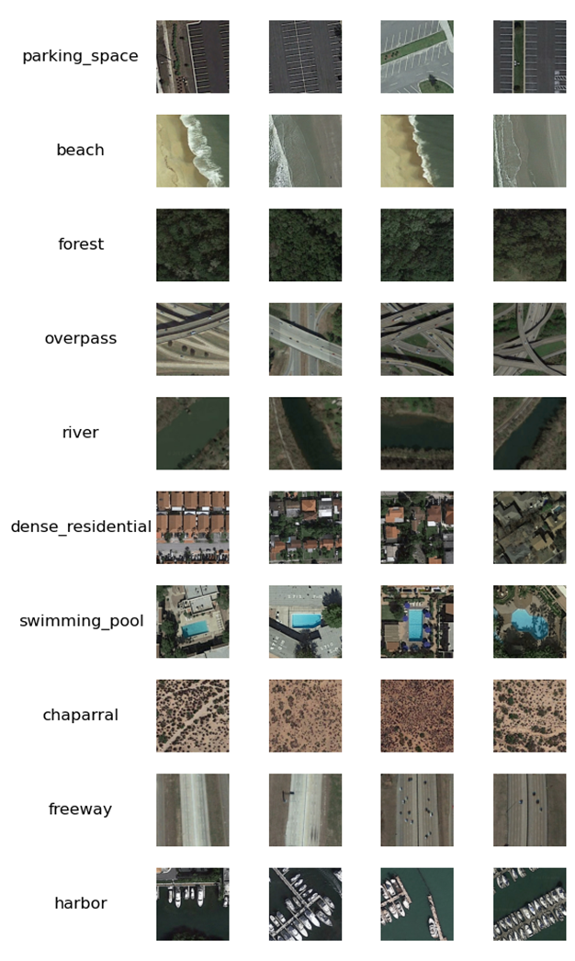
Image Dataset
Motivation
Classification of satellite imagery scenes enables understanding in land use and changes in scenery
Applications in climate studies, defense and war, navigation and mapping, agricultural and urban planning, etc.
Dataset
PatternNet is a high-resolution remote-sensing dataset generated using Google Earth imagery
800 JPEG images for each of 38 classes
Images were manually labeled
10 classes were chosen for inclusion in the analysis
Notes:
Our project is motivated by classifying satellite images to understand land use and changes in land-use over time. And this kind of information is useful for climate studies, defense and war, and many other applications.
To do this, we used PattenNet, which is a high-resolution dataset that was generated from Google Earth imagery. It includes 38 classes, each of which has 800 manually labeled JPEG images. And for our project, we limited our scope to 10 classes that had a fairly even mix of man-made vs. natural and water vs. land scenes. So you can see at the right here some examples of the ten classes, which were parking space, beach, forest, overpass, river, dense residential, swimming pool, chaparral, freeway, and harbor.

Slide 5
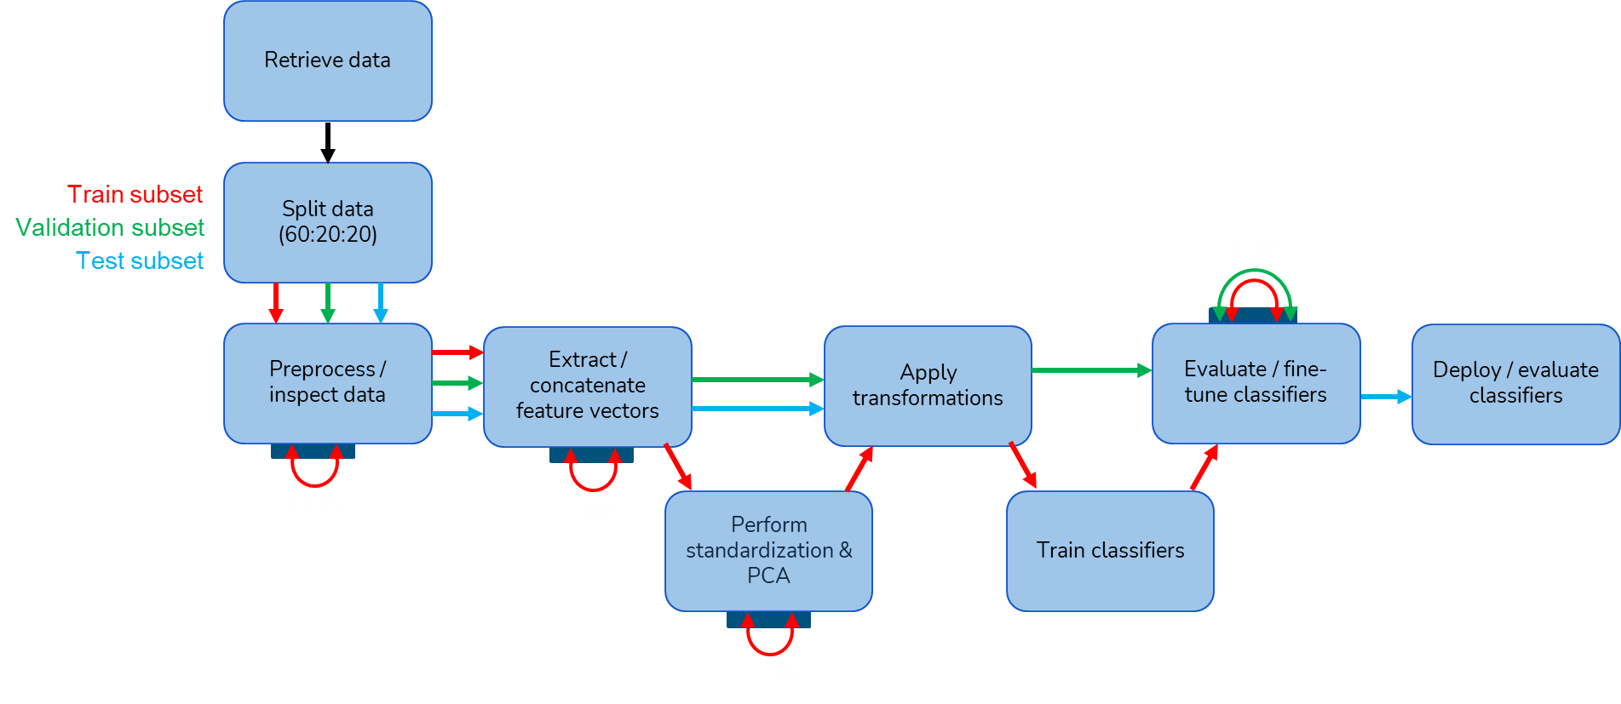
Approach
Notes:
This schematic shows an overview of our data pipeline.
So we first retrieved the data, and immediately split it into train/validation/test subsets at a 60:20:20 ratio. Following that we preprocessed and inspected the data to remove corrupted images, ensured uniformity in resolution and size, and of course we did a bunch of EDA on the train subset for sanity checks.
We then used the train subset to explore a bunch of features, and after selecting them we extracted them and generated a concatenated feature vector for each image. And we used the train subset to perform z-standardization and PCA, during which we did a bunch more EDA like tSNE and elbow plots. We applied those transformations to all of the images to compress the feature vectors.
And then we used the train subset to train two classifiers. Using the validation subset to evaluate performance, we fine-tuned our models. And finally we deployed our tuned models on the train subset to evaluate computational and predictive performance.
======================
Preprocess / inspect data
Remove corrupted images
Inspect datatypes
Ensure uniformity in resolution and size
We did a bunch of EDA on the train subset as sanity checks
Extract/concatenate feature vectors
Here we explored using several features and there was quite a bit of iteration and EDA
Ultimately we selected 6 feature sets for inclusion in the final model and concatenated them together
Perform standardization & PCA
Used the train subset to determine z-standardization and PC model
Apply transformations
Applied the transformations to the

Slide 6
Extracted Features
Each image represented by 1412 features
Mean and standard deviation of each red, green, and blue channel
Histogram of HSV values
Flattened HOG values
Mean GLCM values
Frequency spectrum histograms
SIFT features with Bag of Visual Words applied
Notes:
So ultimately we selected 6 feature-sets for each image, which resulted in 1412 values in each feature vector. And we used color channel information, orientation, texture, and frequency data, as well as a complex feature set using SIFT with Bag of Visual Words.

Slide 7
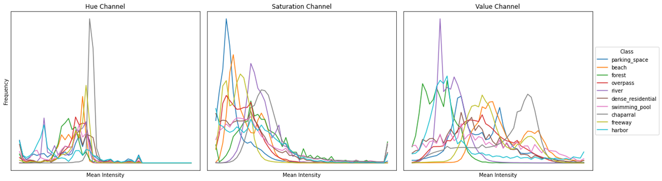
Color Features
RGB
Raw RGB color channel data were presumed useful during visual inspection of image classes
Simple statistics (mean and standard deviation) were computed for each color channel of an image
Each image had 6 RGB features
HSV
Hue, saturation, and value distributions were presumed useful when computing mean histograms for each class
Histograms for each image were consistently binned to determine an approximation to the HSV distribution
Each image had 75 HSV features
Notes:
As I just mentioned, we used color channel information for our features since we saw some pretty big differences during EDA. We computed the mean and standard deviation of each RGB channel, and we also included HSV histograms with 25 bins per channel.

Slide 8
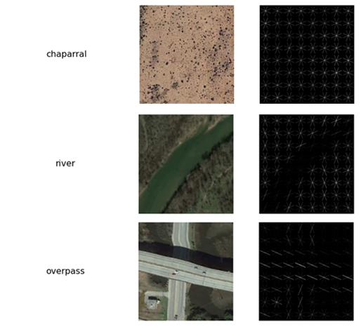
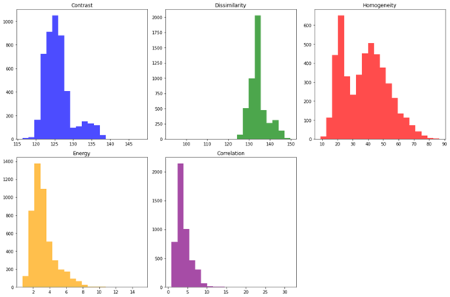
Orientation and Texture Features
Histogram of Orientation Gradients (HOG)
The distribution of gradient orientations is a useful descriptor for local shape and edge information
Images were converted to grayscale and a 32x32 patch was used to compute HOG features
Each image had 1296 HOG features
Gray-level co-occurrence matrices (GLCM)
Textural qualities are determined by measuring the frequency of co-occurring pixel intensities
Images were converted to grayscale then the mean of each GLCM metric was computed given a fixed pixel-offset at 4 angles
Each image had 5 GLCM features
Notes:
We computed the HOG to include features related to local orientation.
And we also included the means of GLCM properties computed using a fixed offset at four angles, which allowed for inclusion of features related to texture.
With that, I’ll pass it over to Muthu.

Slide 9
Spatial Frequency Distribution
Distribution of spatial frequencies vary between images of different classes
Feature extraction in frequency domain is relatively time-efficient; for about 4500 images, extraction takes < 25 seconds
The distribution of spatial frequencies can be leveraged as feature vectors in image classification
We ‘bin’ the frequency distribution into 25 bins
Observations:
PCA on this feature vector yields < 10 components
Training time for this feature vectors is small (< 70 seconds)
Accuracy is between 85 - 87 % on this validation dataset
Notes:
The next feature that we consider is spatial frequency distribution.
Different image classes exhibit different spatial frequency patterns. We can capture those differences and translate them to feature vectors
We run FFT on the images to obtain its frequency components. The frequency distribution obtained is binned into 25 bins. Each image thus has 25 feature-vectors representing spatial frequencies.
Feature extraction in the frequency domain is efficient. For 4500 images, the extraction time was < 25 seconds.
Training time for this feature is also small and is less than 70 seconds.
However, classification accuracy with this dataset is about 85-87%
<NEXT SLIDE>

Slide 10
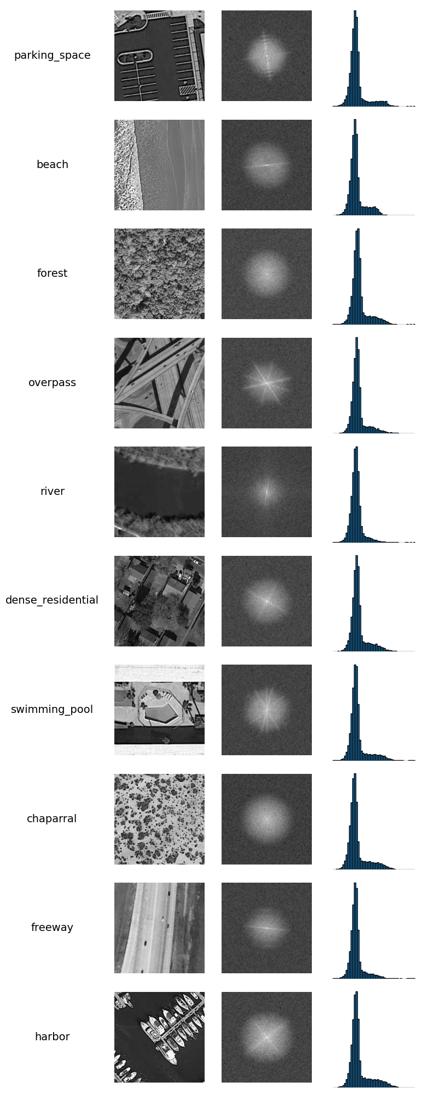
Spatial Frequency Spectrum
Frequency Histograms
Notes:
This shows an EDA of spatial frequencies for images of different classes.
Although the histograms look similar, there are subtle differences in the distribution that can picked by the classifiers.
<NEXT SLIDE PLS>

Slide 11
SIFT (Scale-Invariant Feature Transform)
SIFT feature extraction works by identifying scale and rotation invariant features (local extremas) in an image, termed keypoints
Each keypoint has a descriptor of 128 dimensions
EDA is needed to limit the number of keypoints
edgeThreshold and contractThreshold to identify a reasonable set of endpoints
Using K-Means, we cluster keypoints with similar characteristics (across all images), effectively creating a bag of visual words
For each image, we create a histogram of visual words (on the set of training images)
We then use RF and SVM to train on these histograms and then use the validation set to find the accuracy of this method
Observations
PCA on this feature vector yields < 5 components
Training time for this feature vectors is small (< 100 seconds)
Accuracy is between 32 to 37 % on the validation dataset

Slide 12
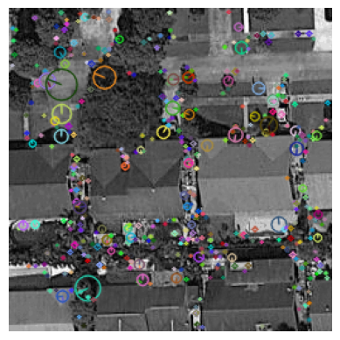
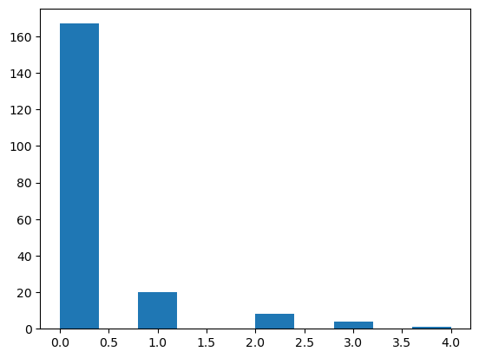
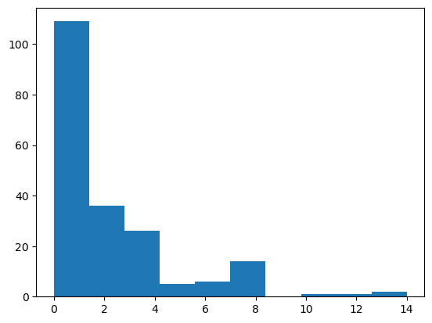
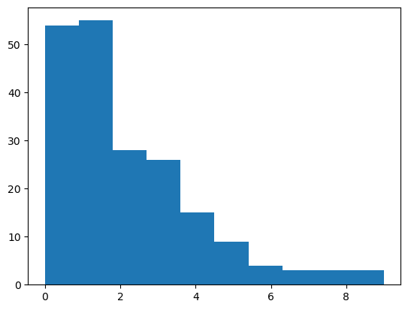
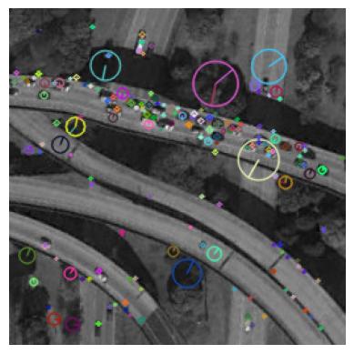
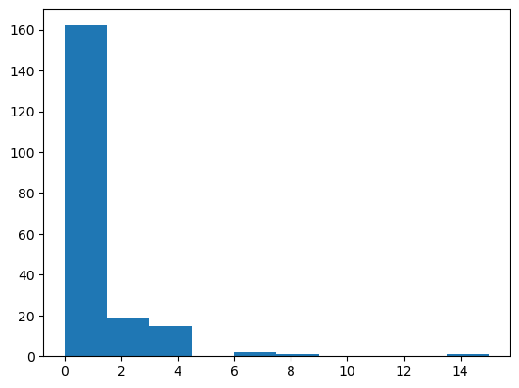
SIFT Features
img1
 | Class | D1 | … | D128
KP1
KP2
…
…
KPn
img2
img3
imgN
Keypoint extraction
Bag of Visual Words clusters using K-Means
Distribution of words used as feature vectors
Edge & contrast thresholds to constrain # of keypoints
Tunable number of clusters
Notes:
The next feature that we cover is SIFT (Scale independent Feature Transform)
SIFT feature extraction works by identifying keypoints in an image. Each keypoint is represented by a 128 dimension vector. Keypoints identify scale and rotation invariant localized features in an image.
EDA is needed to limit the number of keypoints and reduce noise. We fine tune edgeThreshold and contrastThreshold to limit the number of keypoints.
Using K-Means, we cluster keypoints with similar characteristics, effectively creating a bag of visual words
For each image, we create a histogram of visual words (on the set of training images)
SIFT feature extraction is a time-consuming process (About 30 mins for 4500 images).
With PCA, we can reduce the number of feature vectors to less than 10 components.
Although the training time for this feature is < 100 seconds, the accuracy with this approach was really bad.
<NEXT SLIDE>

Slide 13
PCA and tSNE
Some of the feature vectors are high dimensional
Examples: SIFT, HOG
Higher dimensional features incur more computational cost; PCA provides a simpler way to reduce dimensionality.
Run PCA to identify features that have maximal impact to variability in the dataset.
Run tSNE to visualize clustering of data based on the reduced feature vector set identified in the PCA step.
Subsequent stages will subject the data to standard scaling and then do a PCA fit-transform to work on the more important feature vectors.
Notes:
Some of the feature like SIFT or HOG are high dimensional by nature.
Higher dimensional features incur more computational cost;
PCA provides a simpler way to reduce dimensionality.
We run PCA to identify features that have maximal impact on dataset variability.
We use tSNE to visualize clustering of data based on the principal components.
Subsequent stages of our pipeline will enforce standard scaling and a PCA fit-transform, before training classifers.
<NEXT SLIDE>

Slide 14
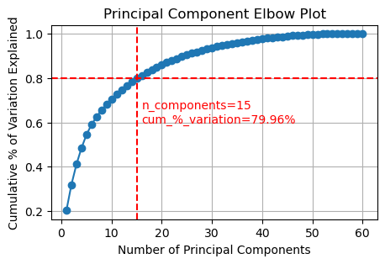
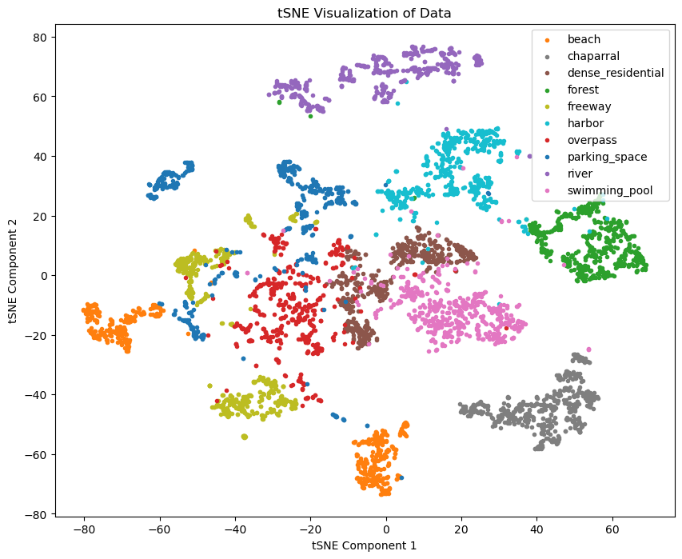
PCA, tSNE with HSV vectors
Notes:
This is an example of the PCA elbow plot and tSNE plot for the HSV feature set.
<NEXT SLIDE>

Slide 15
Classifiers
Random Forest Classifier
Ensemble classifier based on decision trees
Suited for multiclass problems
Scales with large datasets
Hyperparameters: number of trees, number of features, max_depth determined by grid search
Support Vector Machine
Uses one-against-rest approach for multiclass problems
Large dimensions can impact the training efficiency
Relies on distances separating class boundaries
Can work with linear, polynomial and radial boundaries; this makes it really useful for some type of data
Notes:
We use Random Forest and SVM classifiers for our project.
Random Forest Classifiers are known to perform well with large datasets and are suited for multiclass problems.
SVMs, on the other hand employ a one-vs-rest approach for multi-class problems. SVMs can segregate data on linear, polynomial and radial boundaries which makes them suitable for multi-dimensional data.
Random Forest Classifiers require hyperparameter tuning - including number of trees and the depth of each tree.
SVM also require hyperparameter tuning including choice of kernel and the cost-value
Both these hyperparameters are obtained by using GridSearch.
i will now hand this off to Maiya for further presentation.
<NEXT SLIDE>

Slide 16
Model Optimization
GridSearch
All features:
Random Forest
Estimators: 100, 200, 300
Max depth: none, 10, 20
SVM
C: 0.1, 1, 10
Kernel: linear, rbf
HSV and GLCM only (best performing feature types):
Random Forest
Estimators: 100, 200, 300
Max depth: none, 10, 20
SVM
C: 0.1, 1, 10
Kernel: linear, rbf

Slide 17
Accuracy vs Efficiency
Feature | Extraction Time | # Components & Cumulative % Variance at Inflection Point* | Training Time |  | Accuracy
 |  |  | RFC | SVM | RFC | SVM
RGB | 0:00:11.83 | 2 (97.2%) | 0:00:43.06 | 0:00:10.78 | 0.6823 | 0.677
HSV | 0:00:28.32 | 15 (80 %) | 0:01:21.79 | 0:00:07.59 | 0.9681 | 0.9843
HOG | 0:00:37.142 | 165 (94.60%) | 0:05:57.54 | 0:10:38.53 | 0.86241 | 0.91994
GLCM | 0:02:20.250 | 3 (97.6 %) | 0:00:40.11 | 0:00:06.93 | 0.88555 | 0.8824
Spatial Freq | 0:00:42.996 | 7 (90.51%) | 0:01:07.16 | 0:00:09.66 | 0.8549 | 0.8749
SIFT | 0:25:43.613 | 5 (92.4%) | 0:01:06.80 | 0:00:08.55 | 0.320 | 0.359
All the above | 0:29:32.39 | 182 (93.8%) | 0:05:48.09 | 0:00:24.03 | 0.9349 | 0.9881
HSV + GLCM | 0:02:50.67 | 17 (82.3%) | 0:01:39.01 | 0:00:06.57 | 0.9781 | 0.9912
1
2
Based on 4500 training images across 10 classes
Accuracy based on 1600 validation images across 10 classes
*Number of PCA components with highest explained variance

Slide 18
Test Evaluation
Our dataset contains 1600 images across the subset of 10 classes; we had isolated about 20% of images at the start of the project for testing
We chose the the two best feature types that have the best combination of efficiency and accuracy: GLCM and HSV
Using the test set, we evaluated the Random Forest and SVM classifiers with the chosen feature types
Random Forest Classifier
Train Accuracy: 1.0
Test Accuracy: 0.9781113195747342
Support Vector Machine
Train Accuracy: 0.9972911023129819
Test Accuracy: 0.9912445278298937

Slide 19
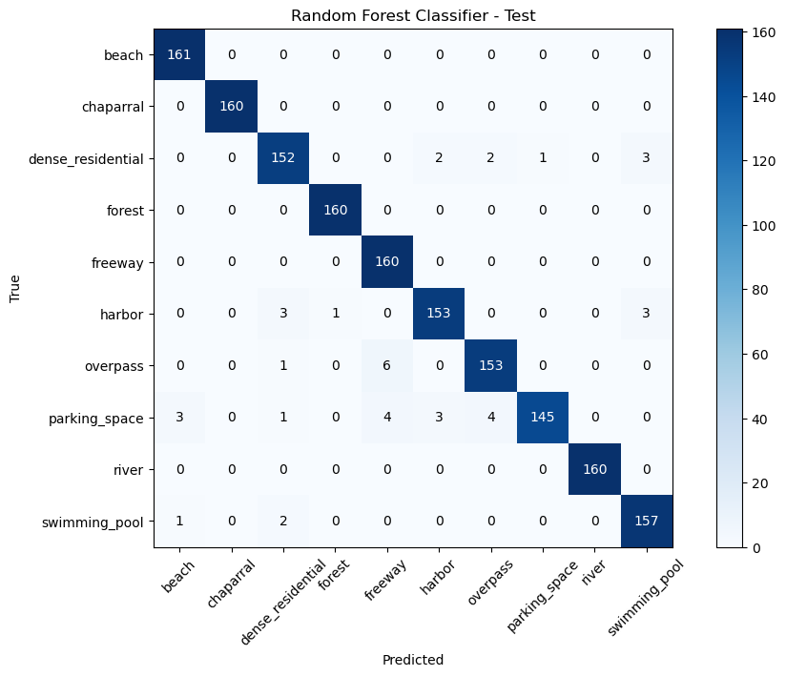

Test Evaluation
HSV + GLCM Features

Slide 20
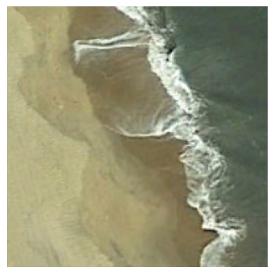
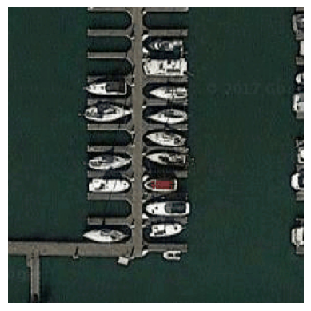
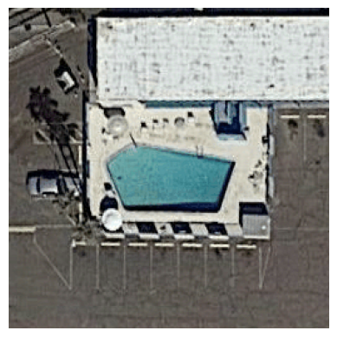
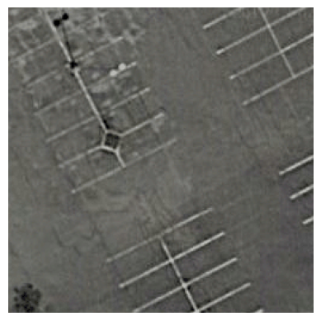
Example Misclassifications
True Class: beach
Predicted Class: parking_space
True Class: Harbor
Predicted Class: parking_space
True Class: swimming_pool Predicted Class: dense_residential
True Class: parking_space
Predicted Class: overpass

Slide 21
Summary
Terrain surveillance image dataset
EDA
Extracted various features and aggregated into feature vectors
Most of the components that explained the highest amount of variance using the full concatenated feature vector were HOG
More than 80% of the 182 resulting components were HOG features!
Found using HSV features alone in our classifiers surprisingly performed very well
HSV + GLCM performed optimally
SVM
Notes:
Reiterate findings, conclusion

Slide 22
Thank you!
Q&A

Slide 23
Old Content

Slide 24
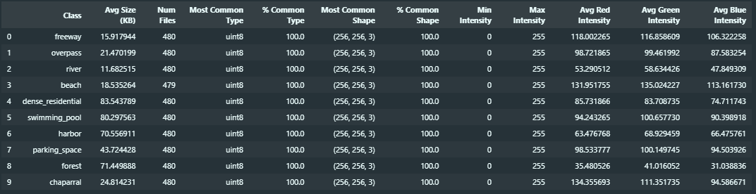
Image Preprocessing
Import data, remove corrupt files
Split data into train/validation/test subsets (60/20/20)
Apply transformations; ensure common shape and data types
Investigate training dataset

Slide 25
Data Pipeline
PatternNet images
Classification
Beach
Remove missing data, unusable images
Data preprocessing
Model training
Ensure uniformity in resolution, size
Split data into training, validation, testing sets (60/20/20)
Augment images for better generalization (i.e. rotations, translations, add contrast, brightness, saturation, etc.)
Feature extraction
Color histograms
Edges
Texture

Slide 26
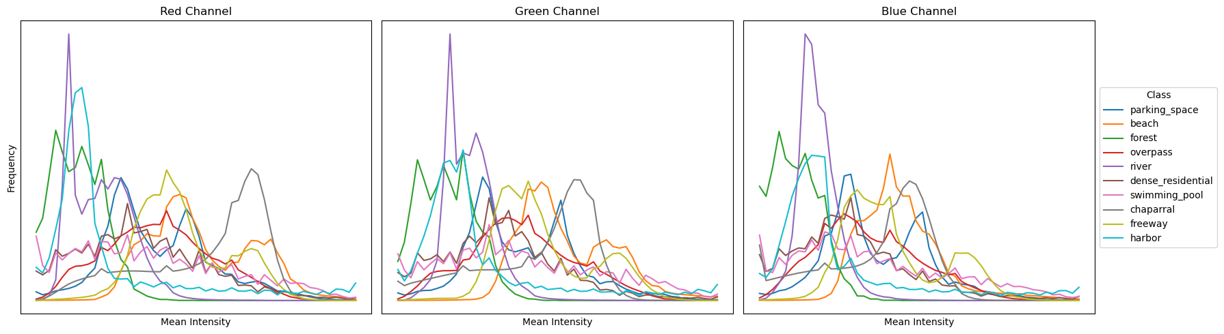
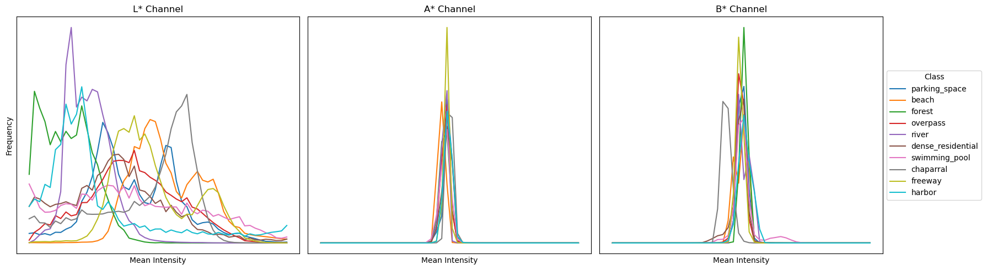
EDA
RGB and L*a*b* channel distributions

Slide 27
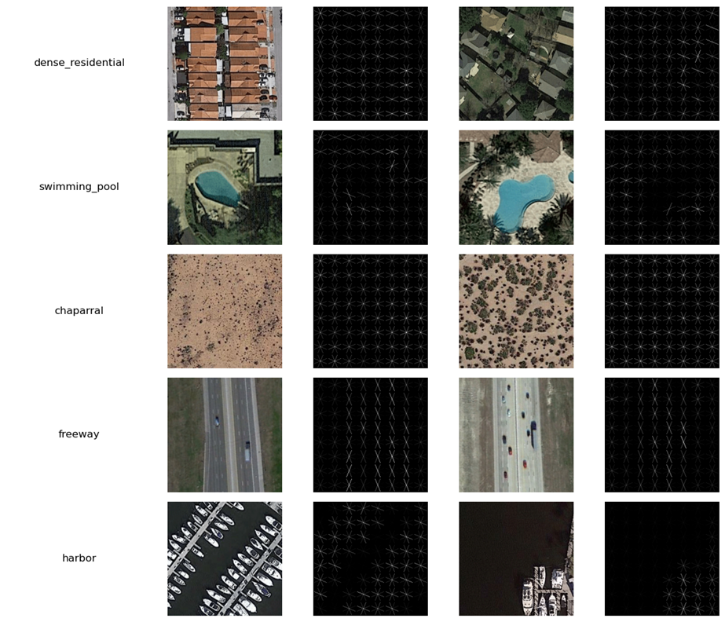
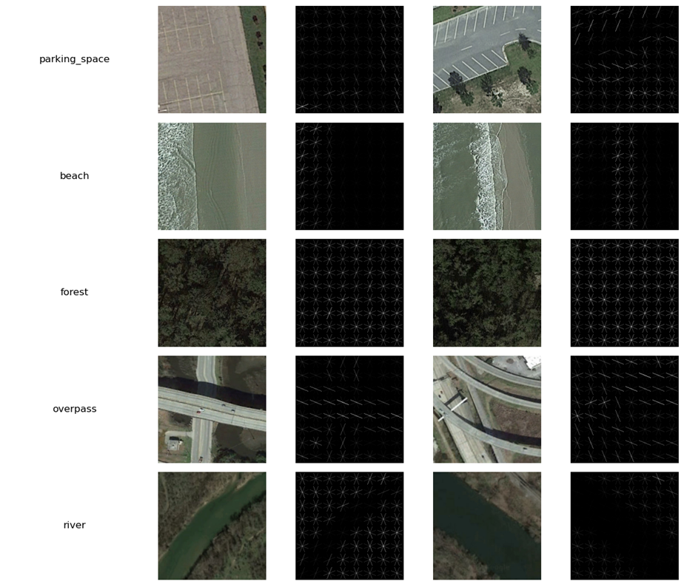
EDA
HOG Features
Convert image to grayscale
Use (32,32) patches
Compute and flatten HOG features
Visualize HOG of random samples

Slide 28
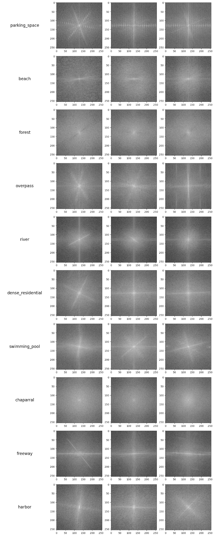
EDA
Fourier Transforms
Notes:
Are there any techniques to extract unique signatures for a given class (based on frequency, phase characteristics)?
All images will have the sharp cutoff at the edges. Should we be applying gaussian filters to smoothen the edges?

Slide 29
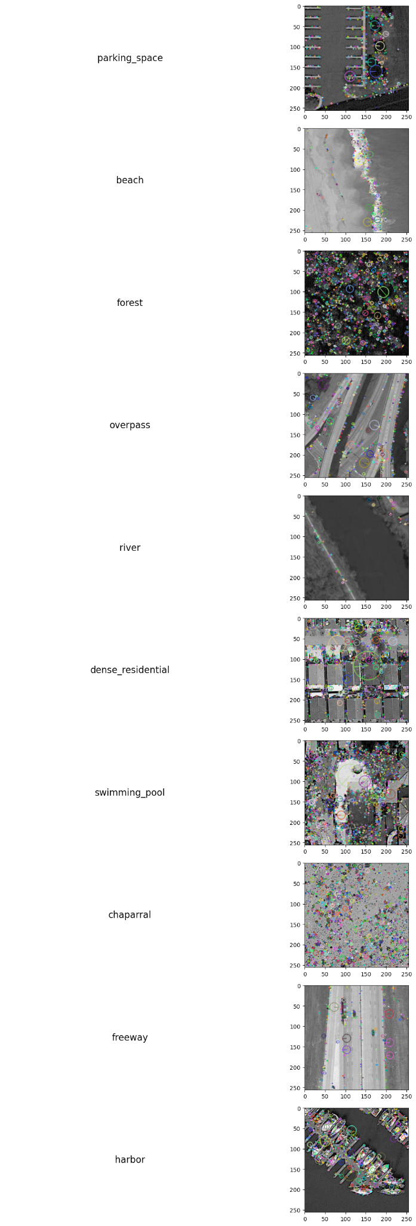
EDA
Scale Invariant Feature Transform
Notes:
Identify keypoints that are scale and orientation invariant
These are good for identifying keypoints that have constant spatial relationships, if all of them belong to the same class. How can this help in classification of random images?

Slide 30
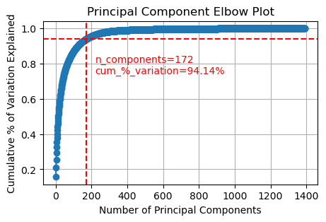
PCA plot
Feature Vectors
RGB (6)
HSV (60)
HOG (1296)
GLCM (25)
FFT (25)
Pending:
SIFT

Slide 31
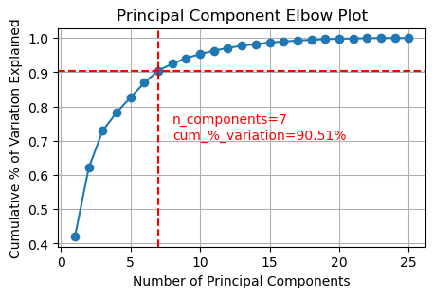
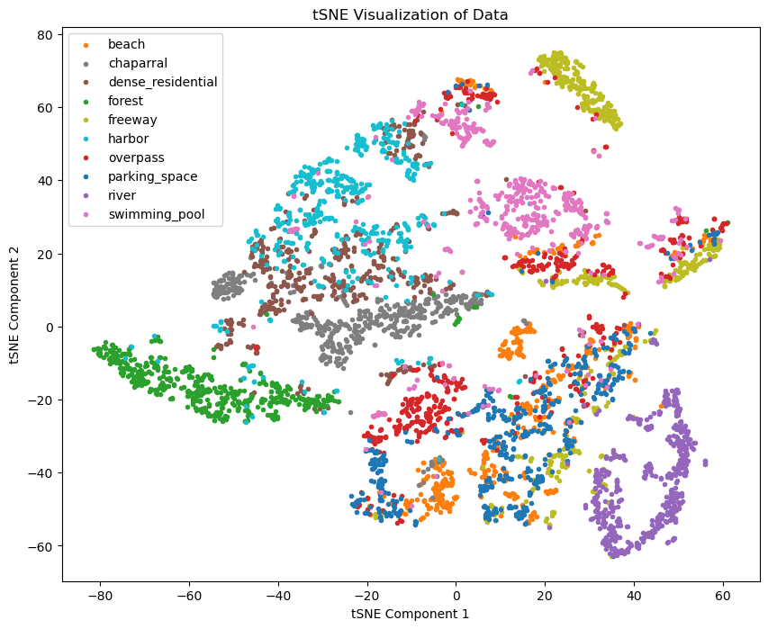
PCA, tSNE with FreqSpectrum vectors
Best parameters for Random Forest Classifier: {'max_depth': None, 'n_estimators': 100}
Training time for Random Forest Classifier: 0:01:07.164655
Best parameters for Support Vector Machine: {'C': 10, 'kernel': 'rbf'}
Training time for Support Vector Machine: 0:00:09.667977
Random Forest Classifier:
Train Accuracy: 1.0
Validation Accuracy: 0.8549093183239524
Support Vector Machine:
Train Accuracy: 0.9124817670347989
Validation Accuracy: 0.8749218261413383
Time taken for feature extraction: 0:00:42.996688

Slide 32
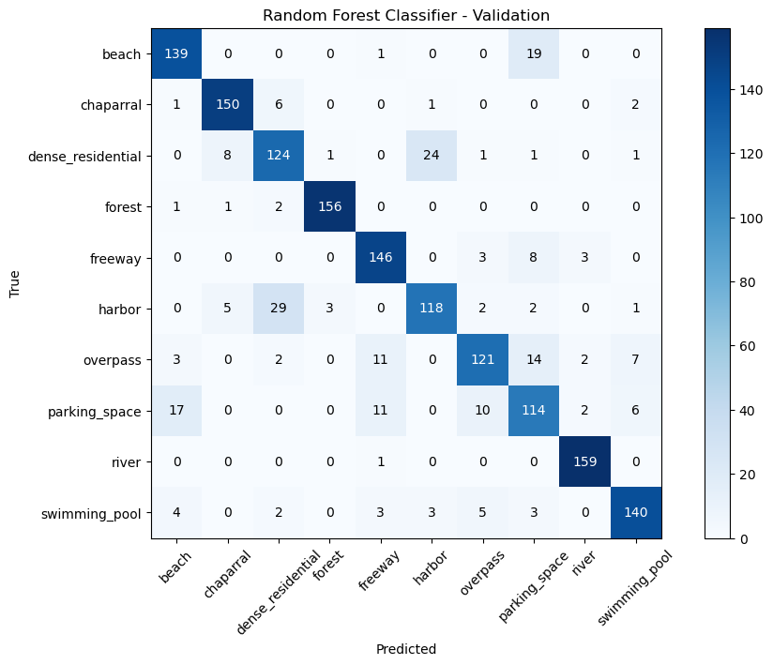
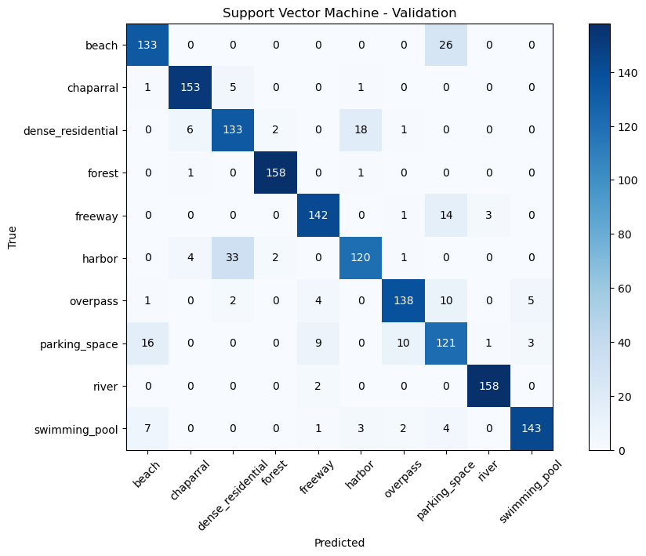
Confusion Matrix with FreqSpectrum vectors

Slide 33
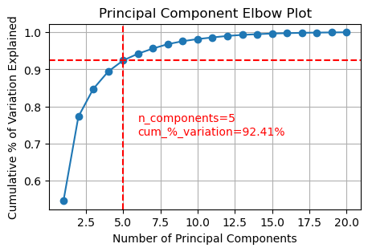
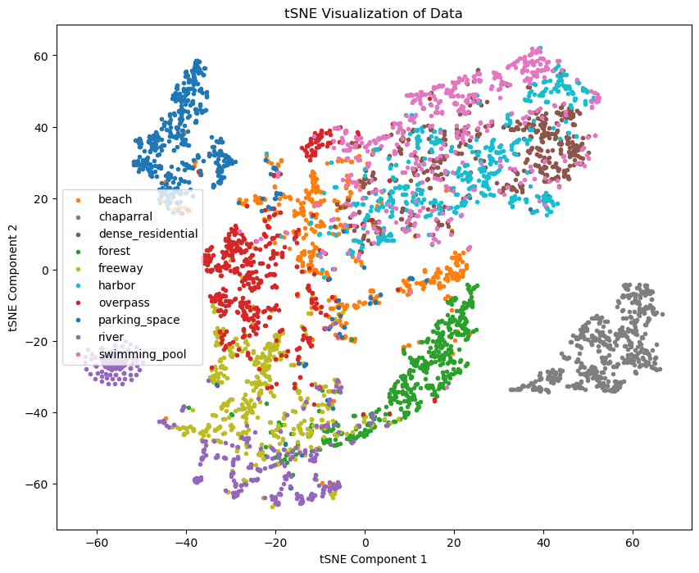
PCA, tSNE with SIFT vectors
Best parameters for Random Forest Classifier: {'max_depth': 20, 'n_estimators': 300}
Training time for Random Forest Classifier: 0:01:06.800111
Best parameters for Support Vector Machine: {'C': 10, 'kernel': 'rbf'}
Training time for Support Vector Machine: 0:00:08.553979
Random Forest Classifier:
Train Accuracy: 0.9981246092936028
Validation Accuracy: 0.32020012507817386
Support Vector Machine:
Train Accuracy: 0.8437174411335695
Validation Accuracy: 0.3595997498436523
Time taken for feature extraction: 0:25:43.613395

Slide 34
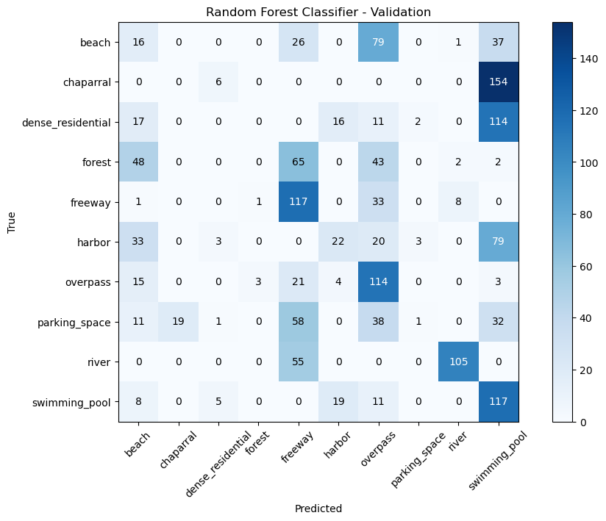
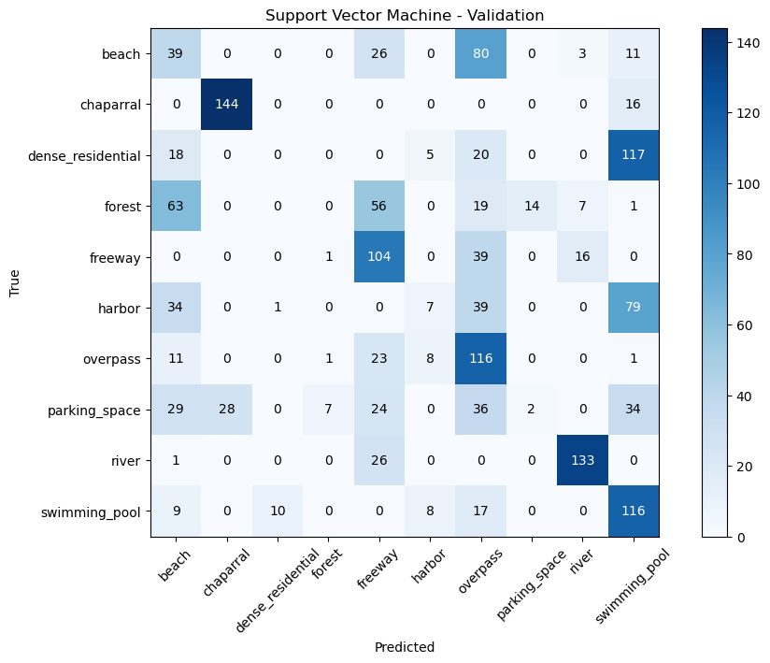
Confusion Matrix with SIFT vectors

Slide 35
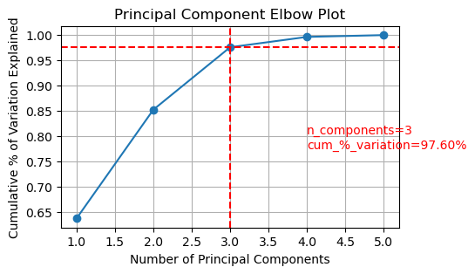
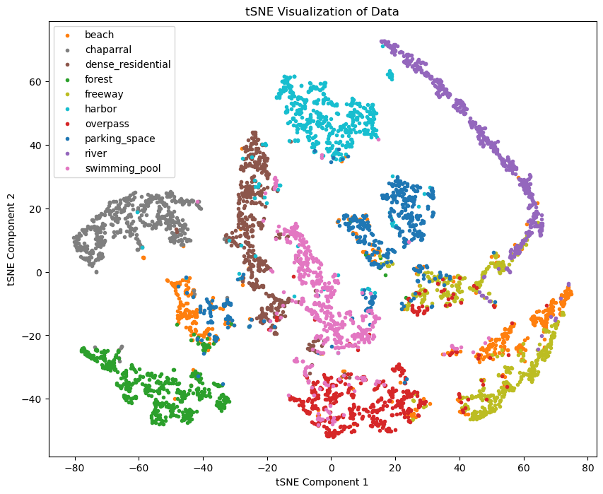
PCA, tSNE with GLCM vectors
Best parameters for Random Forest Classifier: {'max_depth': None, 'n_estimators': 100}
Training time for Random Forest Classifier: 0:00:40.109018
Best parameters for Support Vector Machine: {'C': 10, 'kernel': 'rbf'}
Training time for Support Vector Machine: 0:00:06.930776
Random Forest Classifier:
Train Accuracy: 1.0
Validation Accuracy: 0.8855534709193246
Support Vector Machine:
Train Accuracy: 0.8887268180871015
Validation Accuracy: 0.8824265165728581
Time taken for feature extraction: 0:02:20.250168

Slide 36
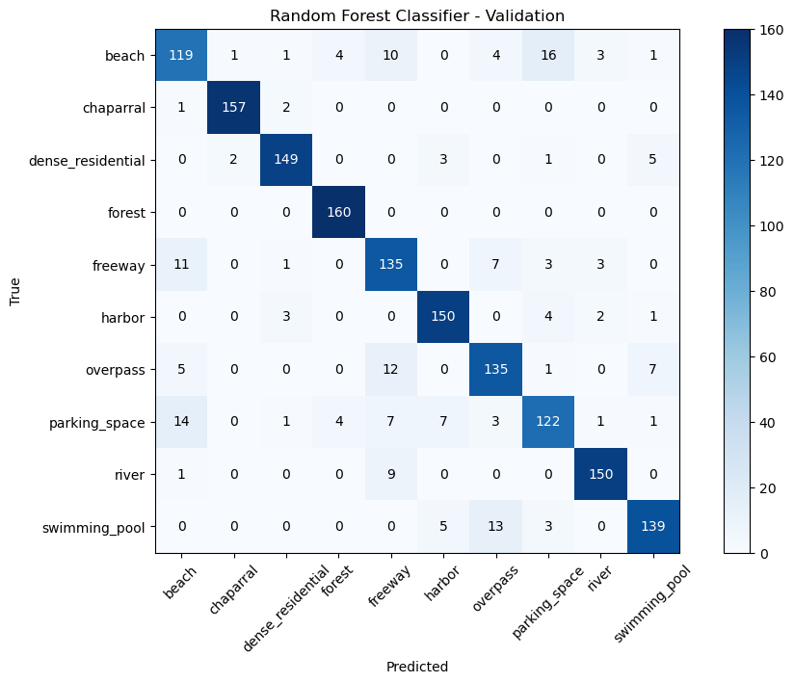
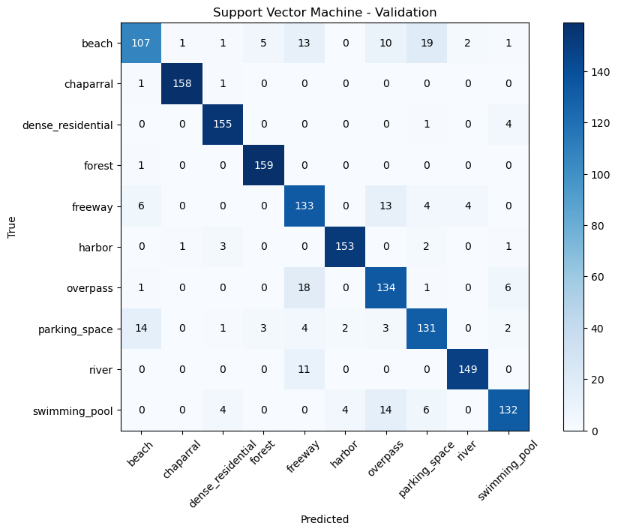
Confusion Matrix with GLCM vectors

Slide 37
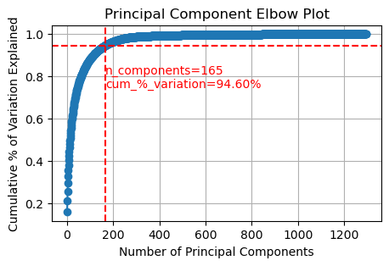
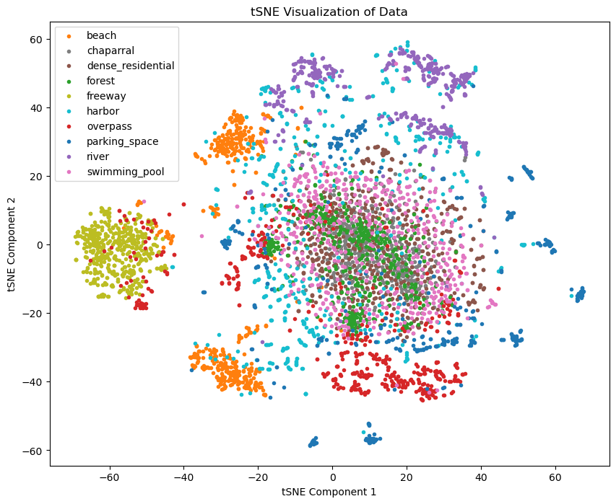
PCA, tSNE with HOG vectors
Best parameters for Random Forest Classifier: {'max_depth': 20, 'n_estimators': 300}
Training time for Random Forest Classifier: 0:05:57.542895
Best parameters for Support Vector Machine: {'C': 10, 'kernel': 'rbf'}
Training time for Support Vector Machine: 0:10:38.536004
Random Forest Classifier:
Train Accuracy: 1.0
Validation Accuracy: 0.8624140087554721
Support Vector Machine:
Train Accuracy: 0.9881225255261513
Validation Accuracy: 0.9199499687304565
TTime taken for feature extraction: 0:00:37.142503

Slide 38
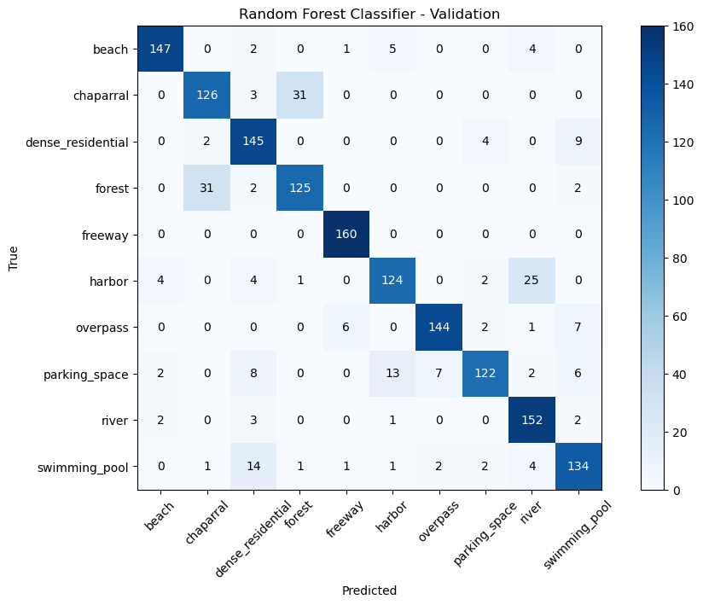
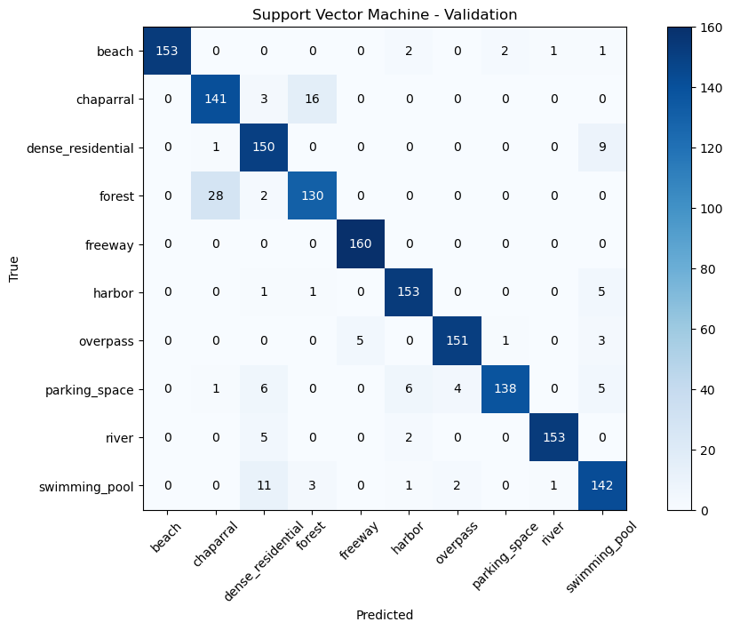
Confusion Matrix with HOG vectors

Slide 39
PCA, tSNE with HSV vectors
Best parameters for Random Forest Classifier: {'max_depth': None, 'n_estimators': 100}
Training time for Random Forest Classifier: 0:01:21.791120
Best parameters for Support Vector Machine: {'C': 10, 'kernel': 'rbf'}
Training time for Support Vector Machine: 0:00:07.592407
Random Forest Classifier:
Train Accuracy: 1.0
Validation Accuracy: 0.9681050656660413
Support Vector Machine:
Train Accuracy: 0.9952073348614294
Validation Accuracy: 0.9843652282676673
Time taken for feature extraction: 0:00:28.322252

Slide 40


Confusion Matrix with HSV vectors

Slide 41
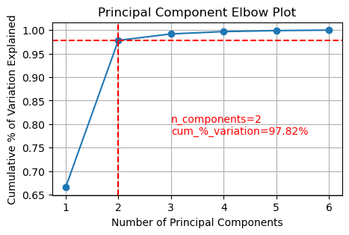
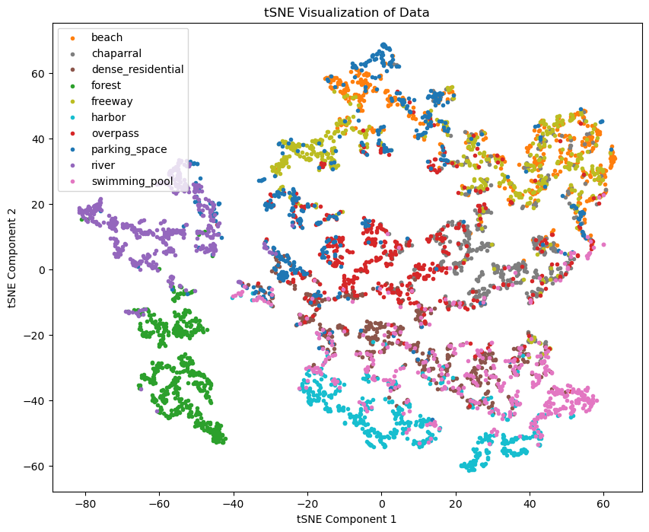
PCA, tSNE with RGB vectors
Best parameters for Random Forest Classifier: {'max_depth': 10, 'n_estimators': 200}
Training time for Random Forest Classifier: 0:00:43.066633
Best parameters for Support Vector Machine: {'C': 10, 'kernel': 'rbf'}
Training time for Support Vector Machine: 0:00:10.782773
Random Forest Classifier:
Train Accuracy: 0.8160033340279225
Validation Accuracy: 0.6823014383989994
Support Vector Machine:
Train Accuracy: 0.7034798916440925
Validation Accuracy: 0.6772983114446529
Time taken for feature extraction: 0:00:11.835436

Slide 42
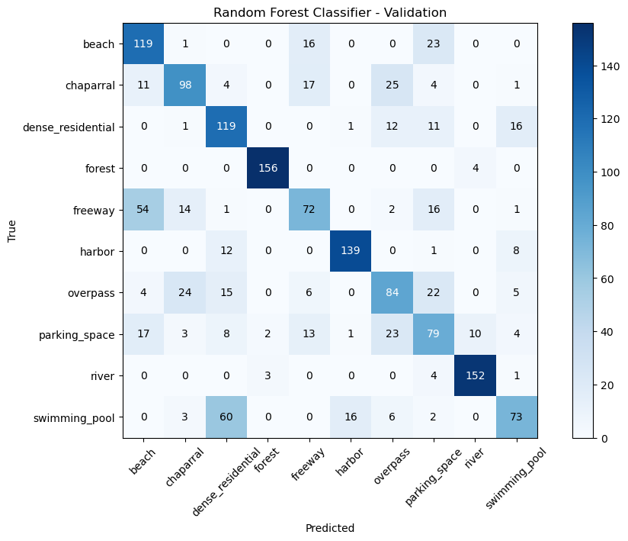
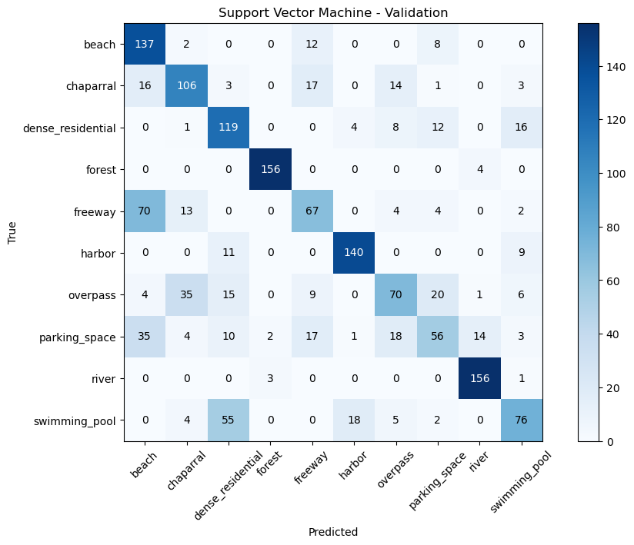
Confusion Matrix with RGB vectors

Slide 43
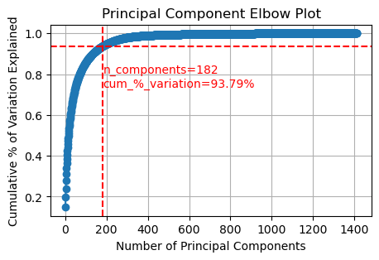
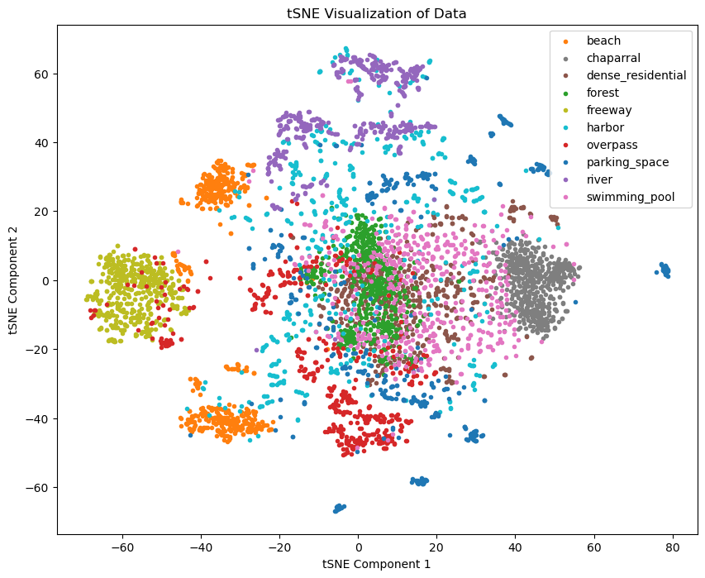
PCA, tSNE with All vectors
Best parameters for Random Forest Classifier: {'max_depth': 20, 'n_estimators': 300}
Training time for Random Forest Classifier: 0:05:48.098878
Best parameters for Support Vector Machine: {'C': 10, 'kernel': 'rbf'}
Training time for Support Vector Machine: 0:00:24.030459
Random Forest Classifier:
Train Accuracy: 1.0
Validation Accuracy: 0.9349593495934959
Support Vector Machine:
Train Accuracy: 1.0
Validation Accuracy: 0.9881175734834271
Time taken for feature extraction: 0:29:32.396792

Slide 44
Confusion Matrix with All vectors

Slide 45
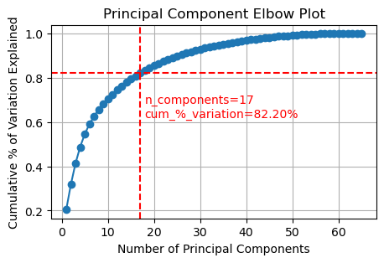

PCA, tSNE with HSV+GLCM vectors
Best parameters for Random Forest Classifier: {'max_depth': None, 'n_estimators': 100}
Training time for Random Forest Classifier: 0:01:39.016715
Best parameters for Support Vector Machine: {'C': 10, 'kernel': 'rbf'}
Training time for Support Vector Machine: 0:00:06.575821
Random Forest Classifier:
Train Accuracy: 1.0
Validation Accuracy: 0.9781113195747342
Support Vector Machine:
Train Accuracy: 0.9972911023129819
Validation Accuracy: 0.9912445278298937
Time taken for feature extraction: 0:02:50.674094

Slide 46


Confusion Matrix with HSV+GLCM vectors

Slide 47
Test Evaluation with HSV and GLCM Features
Best parameters for Random Forest Classifier: {'max_depth': None, 'n_estimators': 100}
Training time for Random Forest Classifier: 0:01:39.016715
Best parameters for Support Vector Machine: {'C': 10, 'kernel': 'rbf'}
Training time for Support Vector Machine: 0:00:06.575821
Random Forest Classifier
Train Accuracy: 1.0
Validation Accuracy: 0.9781113195747342
Support Vector Machine
Train Accuracy: 0.9972911023129819
Validation Accuracy: 0.9912445278298937
Time taken for feature extraction: 0:02:50.674094

